Slide 1
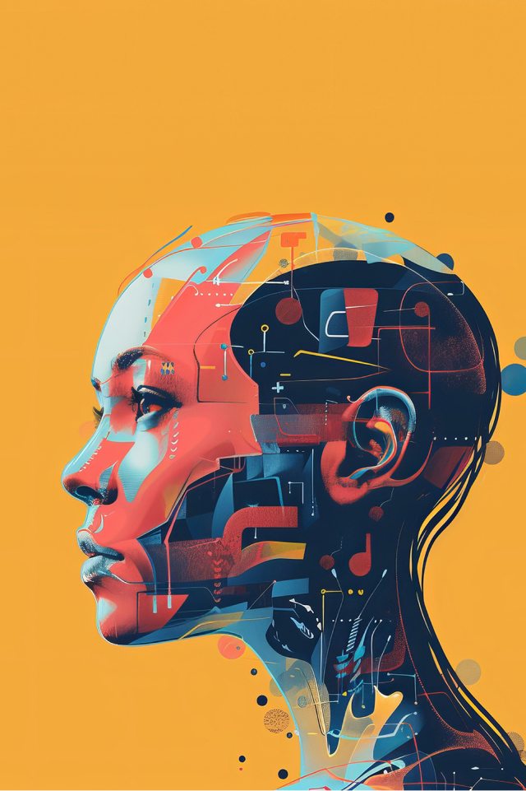
Artificial Intelligence in Everyday life
Made by: Group 2

Slide 2
Agenda
Who we are
Our topic
Main groups and their subtopics
Introduction to AI
AI Technologies
Impact and Ethics
CSS
Git Repo

Slide 3
Who we are
Group Leaders
  Leonida Ilijoska
  Jan Bartos
Git Leader
  Francesco Ardei
CSS Leaders
  Andrea Dell’Agnello
  Alesandro Rohrwasser
Topic Leaders
  Giacomo Demartini
  Eros Butti
  Giulia Mettifogo
  Eliot Boniface
Team Members
  Mark Camarilla
  Luca Clivio
  Mohamed El Bayad
  Daniele Gabriele Gambarota
  Fabio Giandomenico
  Alessio Giugno
  Lexie Jowi
  Fariba Karimi
  Changlong Ma
  Eleonora Marichi
  Minh Nguyen
  Kevin Ortiz Fernández
  Emanuele Tonazzo
  Minh Quan Tran

Slide 4

Our topic
Artificial Intelligence in Everyday Life

Slide 5
Main groups and their subtopics
1. Introduction to AI
2. AI Technologies
3. Impact and Ethics
History of AI
Basic Concepts
Language Technologies
Robotics
Applications
Limitations
Ethics

Slide 6
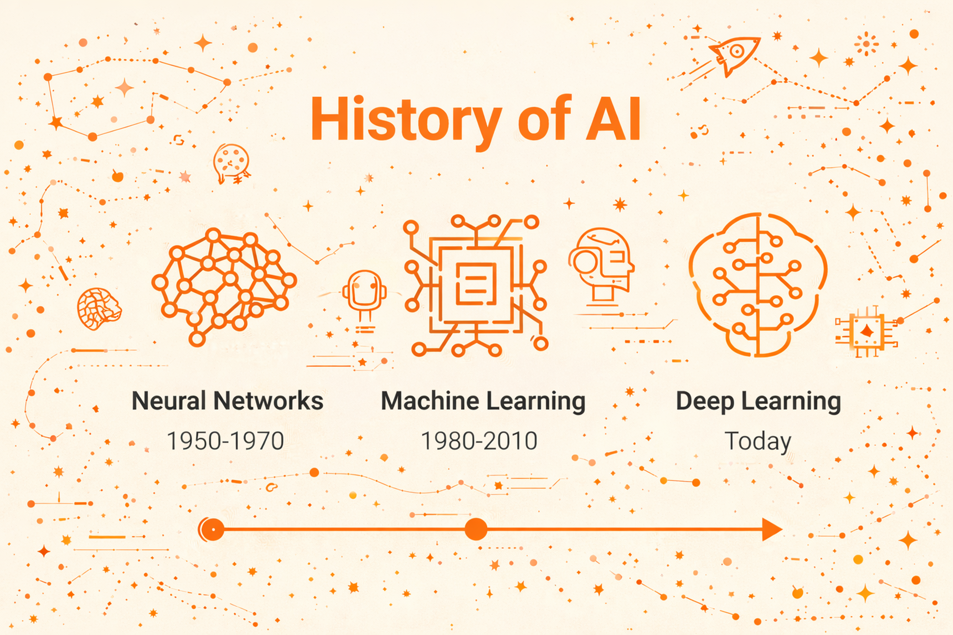
1. Introduction to AI
Topic Leader
  Eros Butti
Team Members
  Mark
  Alessio Giugno
  Luca Clivio
  Mark Camarilla

Slide 7
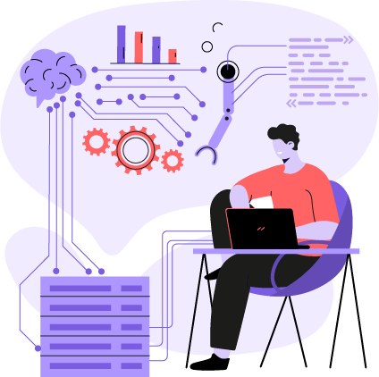
2. AI Technologies
The Members
The subtopics
Topic Leaders
  Giulia Mettifogo
  Giacomo Demartini
Team Members
  Daniele Gabriele Gambarota
  Fabio Giandomenico
  Emanuele Tonazzo
  Minh Quan Tran
  Minh Nguyen
  Mohamed El Bayad
Language Technologies
  Daniele Gabriele Gambarota
  Fabio Giandomenico
Robotics
  Giulia Mettifogo
  Giacomo Demartini
  Emanuele Tonazzo
Applications
  Minh Quan Tran
  Minh Nguyen
  Mohamed El Bayad

Slide 8
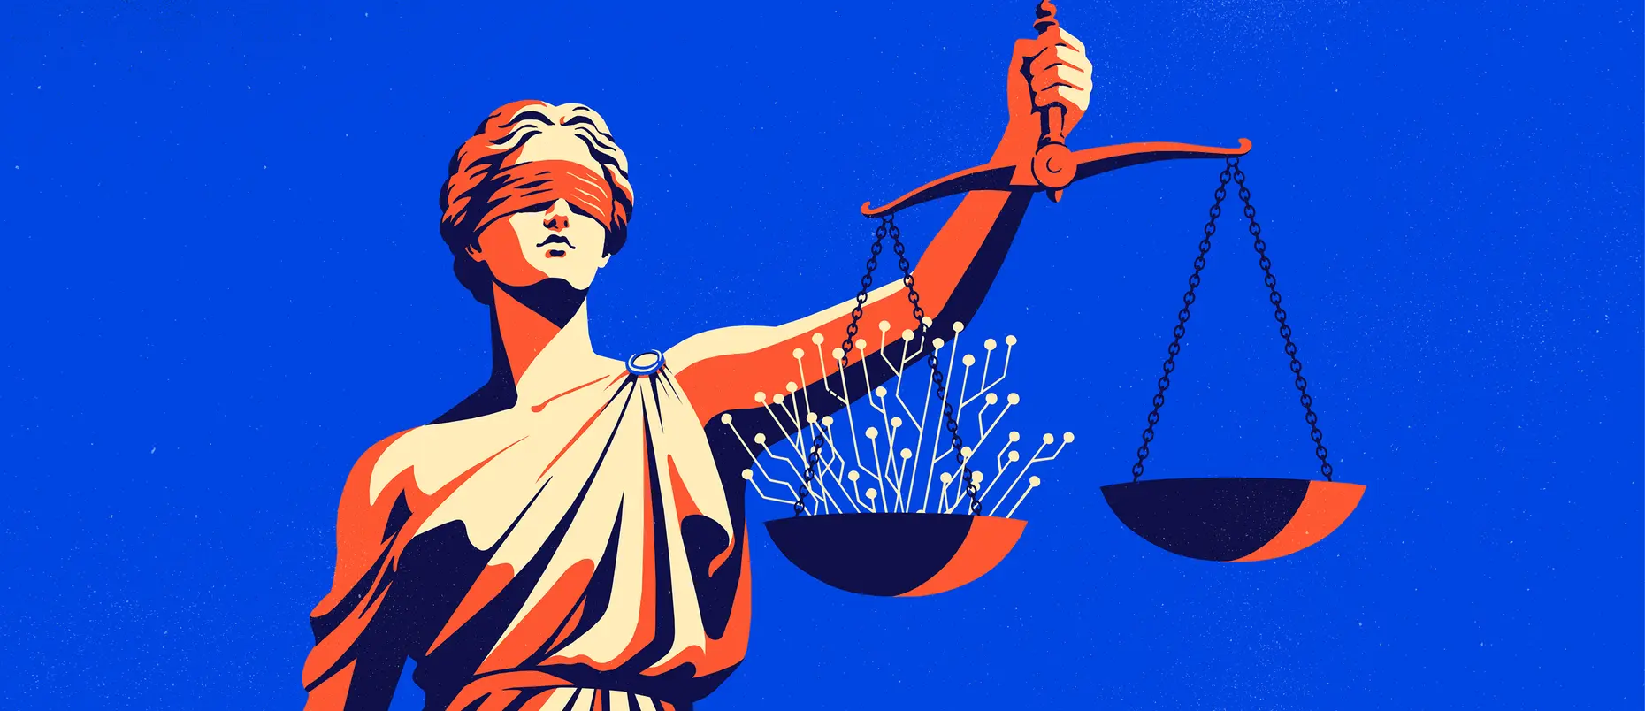
3. Impact and Ethics
Topic Leader
  Eliot Boniface
Team Members
  Changlong Ma
  Eleonora Marichi
  Lexie Jowi

Slide 9
CSS
Andrea Dell’Agnello
Alesandro Rohrwasser
Article Page
Home Page
Home
1. Introduction to AI
Sidebar
1. Introduction to AI
Article 1
-----------------------------------------------------------------------------------
-----------------------------------------------------------------------------------
-----------------------------------------------------------------------------------
-----------------------------------------------------------------------------------
-----------------------------------------------------------------------------------
-----------------------------------------------------------------------------------
-----------------------------------------------------------------------------------
-----------------------------------------------------------------------------------
-----------------------------------------------------------------------------------
-----------------------------------------------------------------------------------
-----------------------------------------------------------------------------------
History
---------
---------
---------
---------
Artificial Intelligence in Everyday Life
2. AI Technologies
Basic Concepts
---------
---------
---------
---------
3. Impact and Ethics
To be decided*

Slide 10
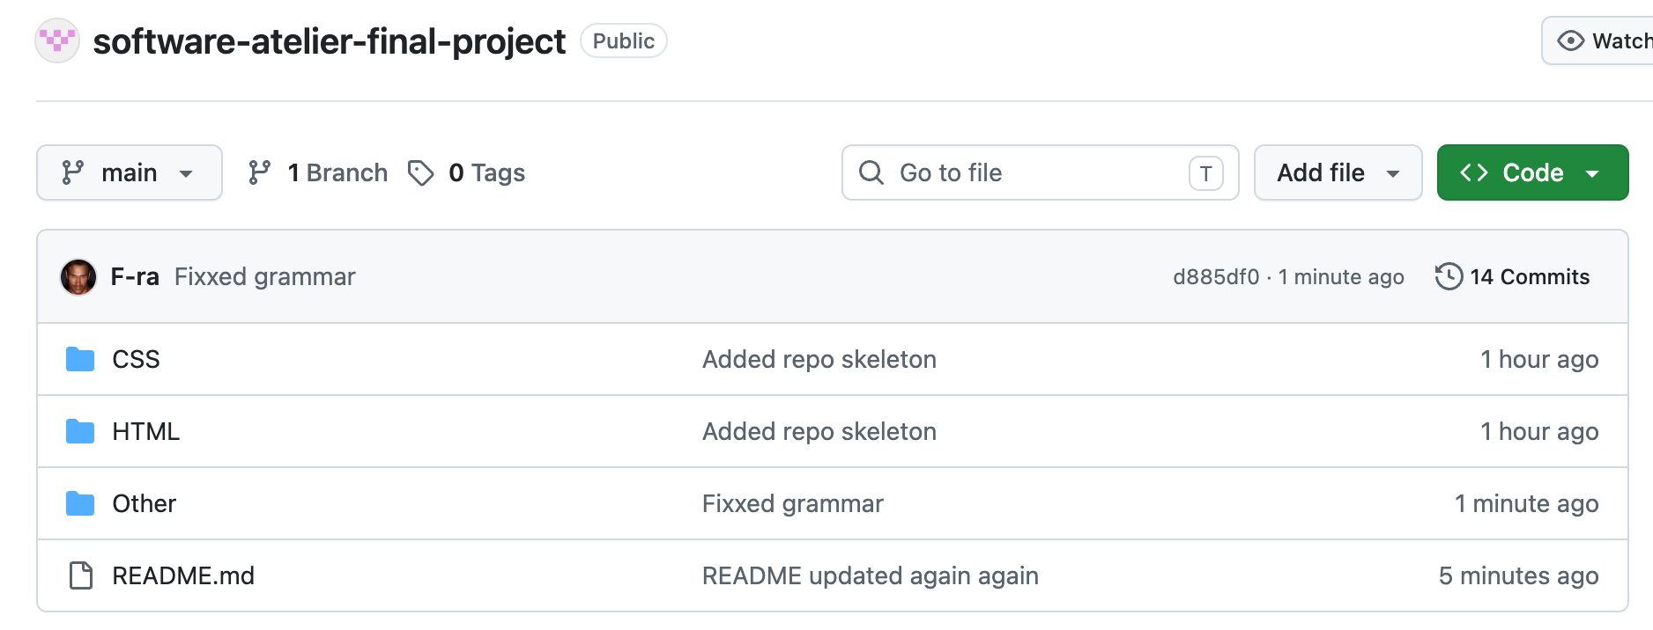

Git Repo
Francesco Ardei

Slide 11
Thank you

Slide 12
Images references
Links in chronological order
  https://spotlight.leeds.ac.uk/leeds-magazine-2025/big-questions/is-ai-our-friend-or-our-enemy/index.html
  https://news.microsoft.com/ai/
  https://www.iso.org/artificial-intelligence/what-is-ai
  https://clay.global/blog/ai-guide/timeline-of-ai
  https://9nexus.com/hire-ai-engineers/
  https://mitsloan.mit.edu/ideas-made-to-matter/ai-ethics-and-governance-where-will-you-draw-line

